Slide 1


Zomato Restaurant Analysis

Slide 2


Today’s Agenda
Project Recap
Business Overview
Data Challenges
Project Insight
Business Problem
Problem Solution

Slide 3


In this presentation, we will analyze Zomato’s restaurant data to uncover the key insights and trends shaping the industry. We will delve into the factors influencing customer preferences and the impact of online food delivery services on the restaurant landscape.
Project Recap

Slide 4
Business
Overview
Founded in 2008 in India.
Operates in 23 + countries and territories.
Offers food ordering, delivery, and table booking services.
Connects millions of users with restaurants of various cuisines and price points.
Plays a significant role in the food delivery industry.
Parent company Info edge.
Founded by Deepinder Goyal and Pankaj Chaddah .

Slide 5
Data
Challenges
Data quality issues: Missing values, inconsistencies, and errors
Data volume: Managing and analysing large datasets
Data variety: Integrating data from various sources (restaurants, users, reviews)
Data security: Protecting sensitive user information

Slide 6
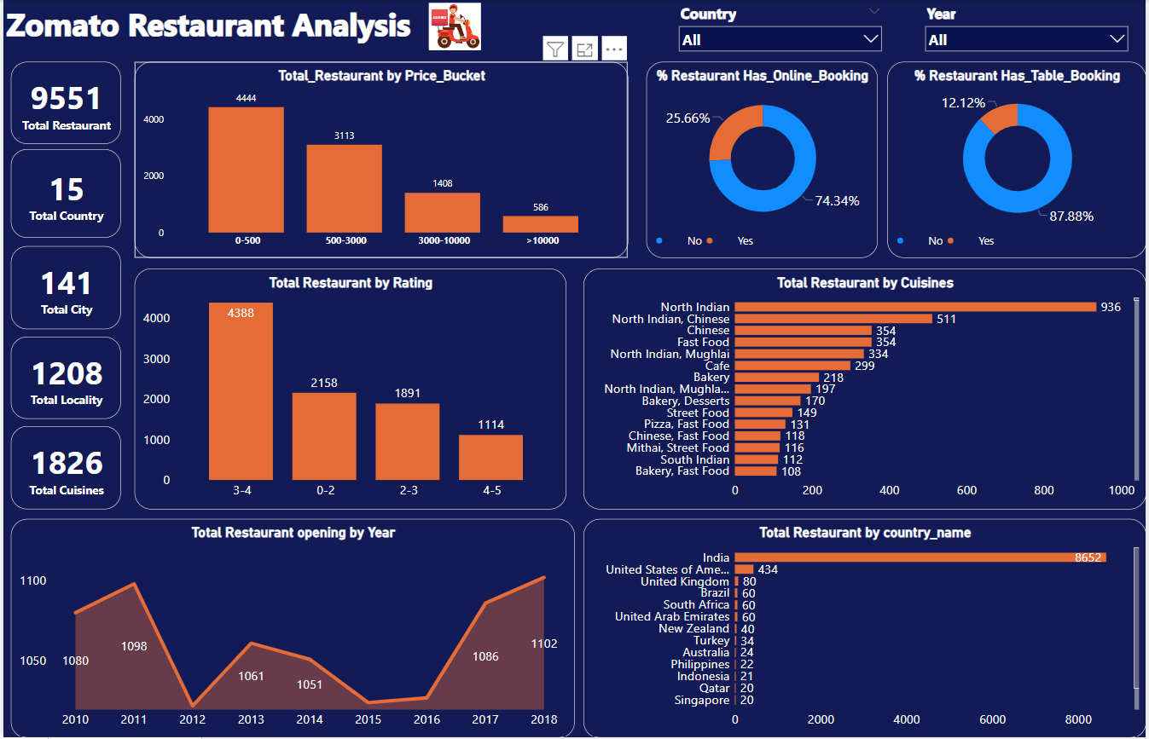
D
A
S
H
B
O
A
R
D

Slide 7
Identifying underperforming restaurants and optimizing their visibility.
Predicting high-demand dishes and ensuring efficient inventory management.
Understanding customer preferences and personalizing recommendations.
Improving delivery efficiency and reducing order cancellation rates.
Identifying the countries or cities where we can focus to get more business.
Business
Problems

Slide 8
Utilize machine learning algorithms to identify underperforming restaurants based on various data points.
Develop forecasting models to predict dish demand based on historical data and seasonal trends.
Leverage user data and behavior patterns to recommend personalized dishes and restaurants.
Optimize delivery routes and schedules using data-driven insights to improve efficiency and reduce cancellations.
Problems
Solution

Slide 9
Thank you!
ANY QUESTIONS?
Presented By -
Gaurav
Sonal
Priyanka
Omkar
Pournima
Vishnu
Sarang

